Slide 1
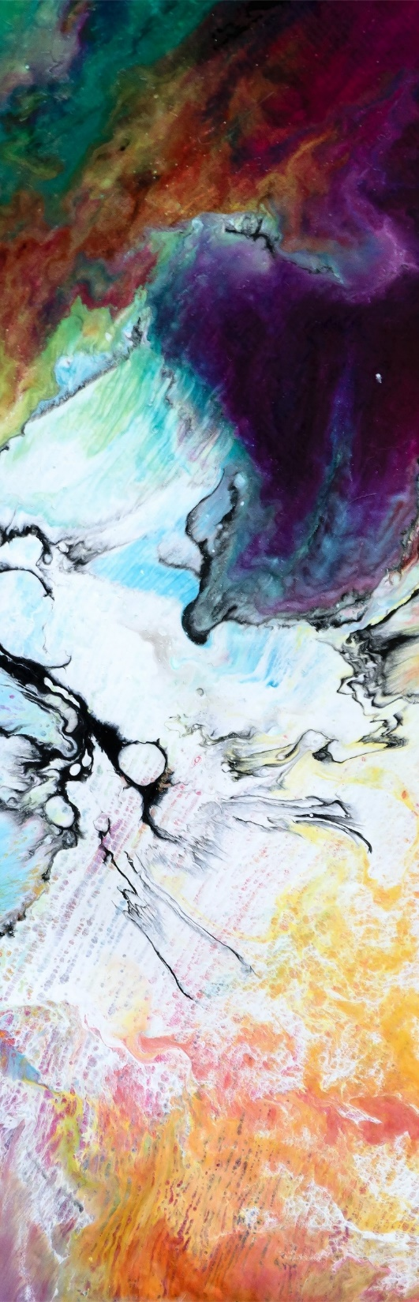




AQI Predictor
AI Based App that predict
AQL just By taking photo
(A project by MPVIR Group)

Slide 2



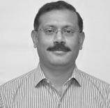
Team
Member 1
Waqas Ahmad
FA16-BCS-047
Member 2
Hamza Sadiq
FA16-BCS-041
Member 3
Ali Hassan
FA16-BCS-162
Supervisor
Dr. Usama Ijaz Bajwa
Assistant Professor & Associate Head of Department

Slide 3
Things you know Before we start
What is AQI?
What do we mean by Air Quality level or AQL?
AQL classification: Good: PM2.5 in the range of 0-74 Average: PM2.5 in the range of 75-115 Bad: PM2.5 above 115
How important is AQI?

Slide 4
INTRODUCTION
Concept to build a system that predict AQL
Android and web based application
Using Deep Learning techniques:
Predict air quality level of any picture.

Slide 5
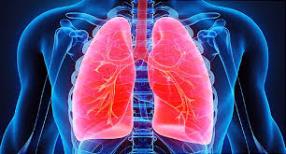
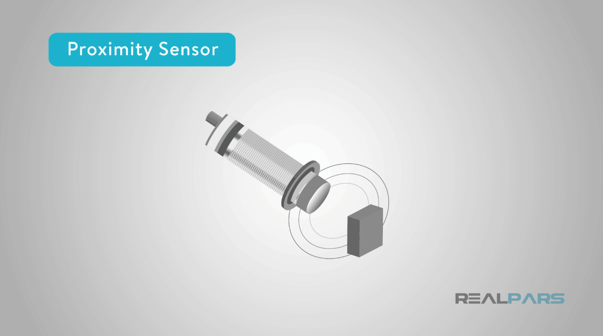
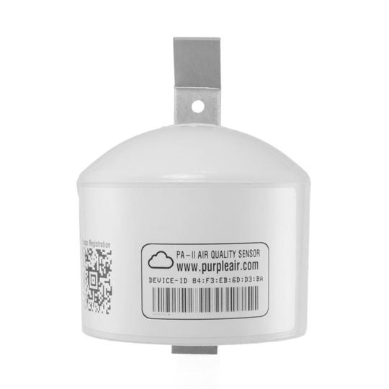
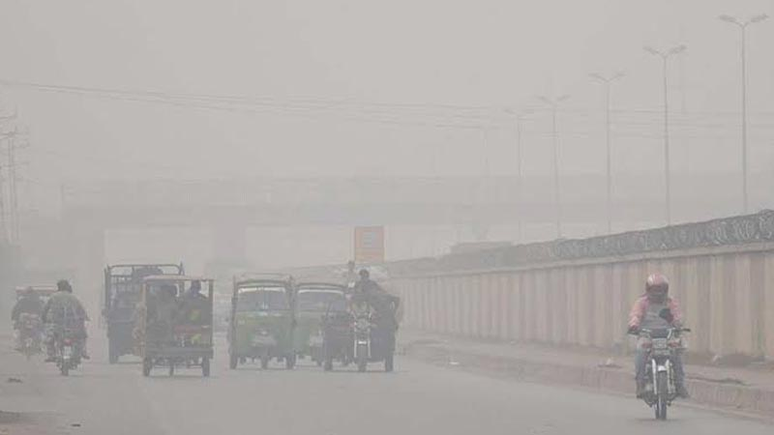
Problems
Expensive Sensors
Lahore Worst AQI Rank
Increasing Respiratory Problems
Sensors
Range

Slide 6
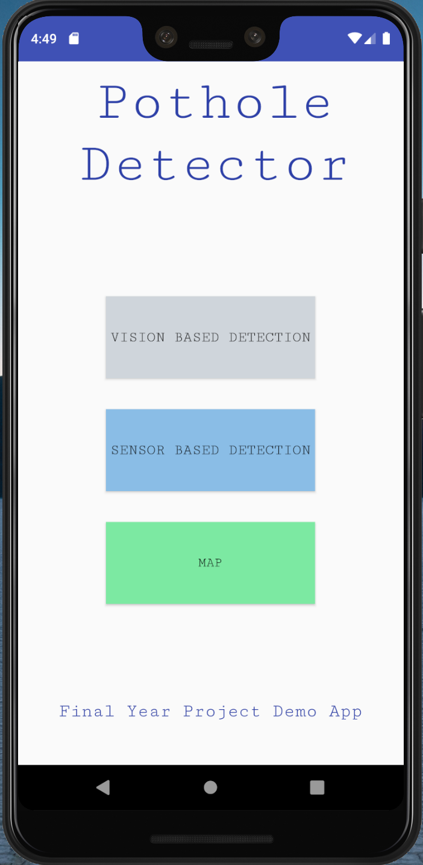
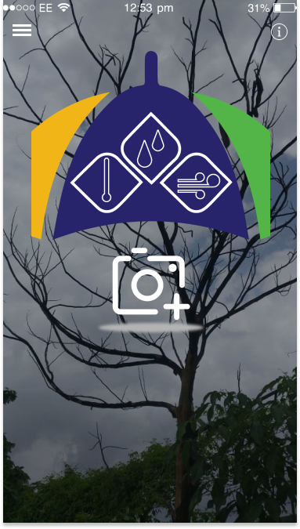
Smart Solution
Our Android & Web Application
An AQI Predictor System that predicts the Air Quality level
It can predict Air Quality level of any place and any time in the world with good light and sky
It can predict AQ level and provide necessary precautions if required

Slide 7
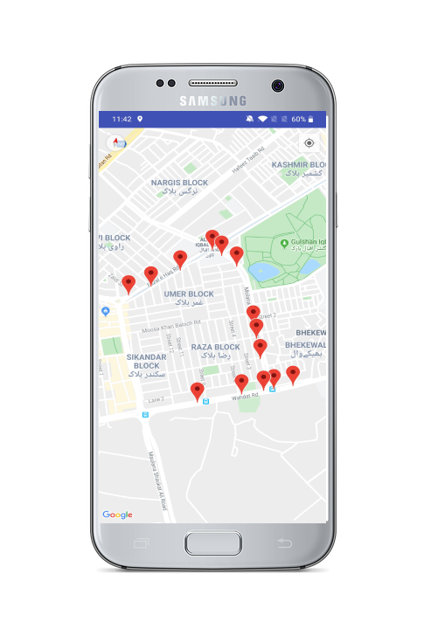
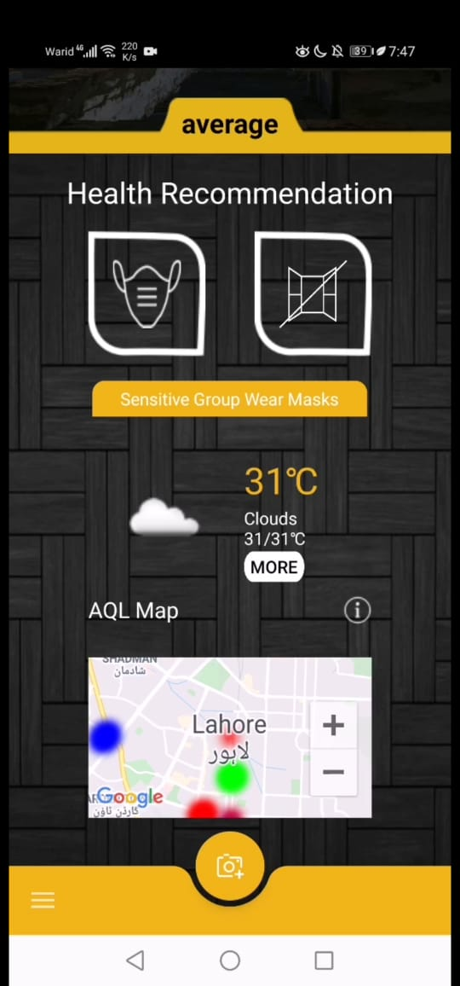
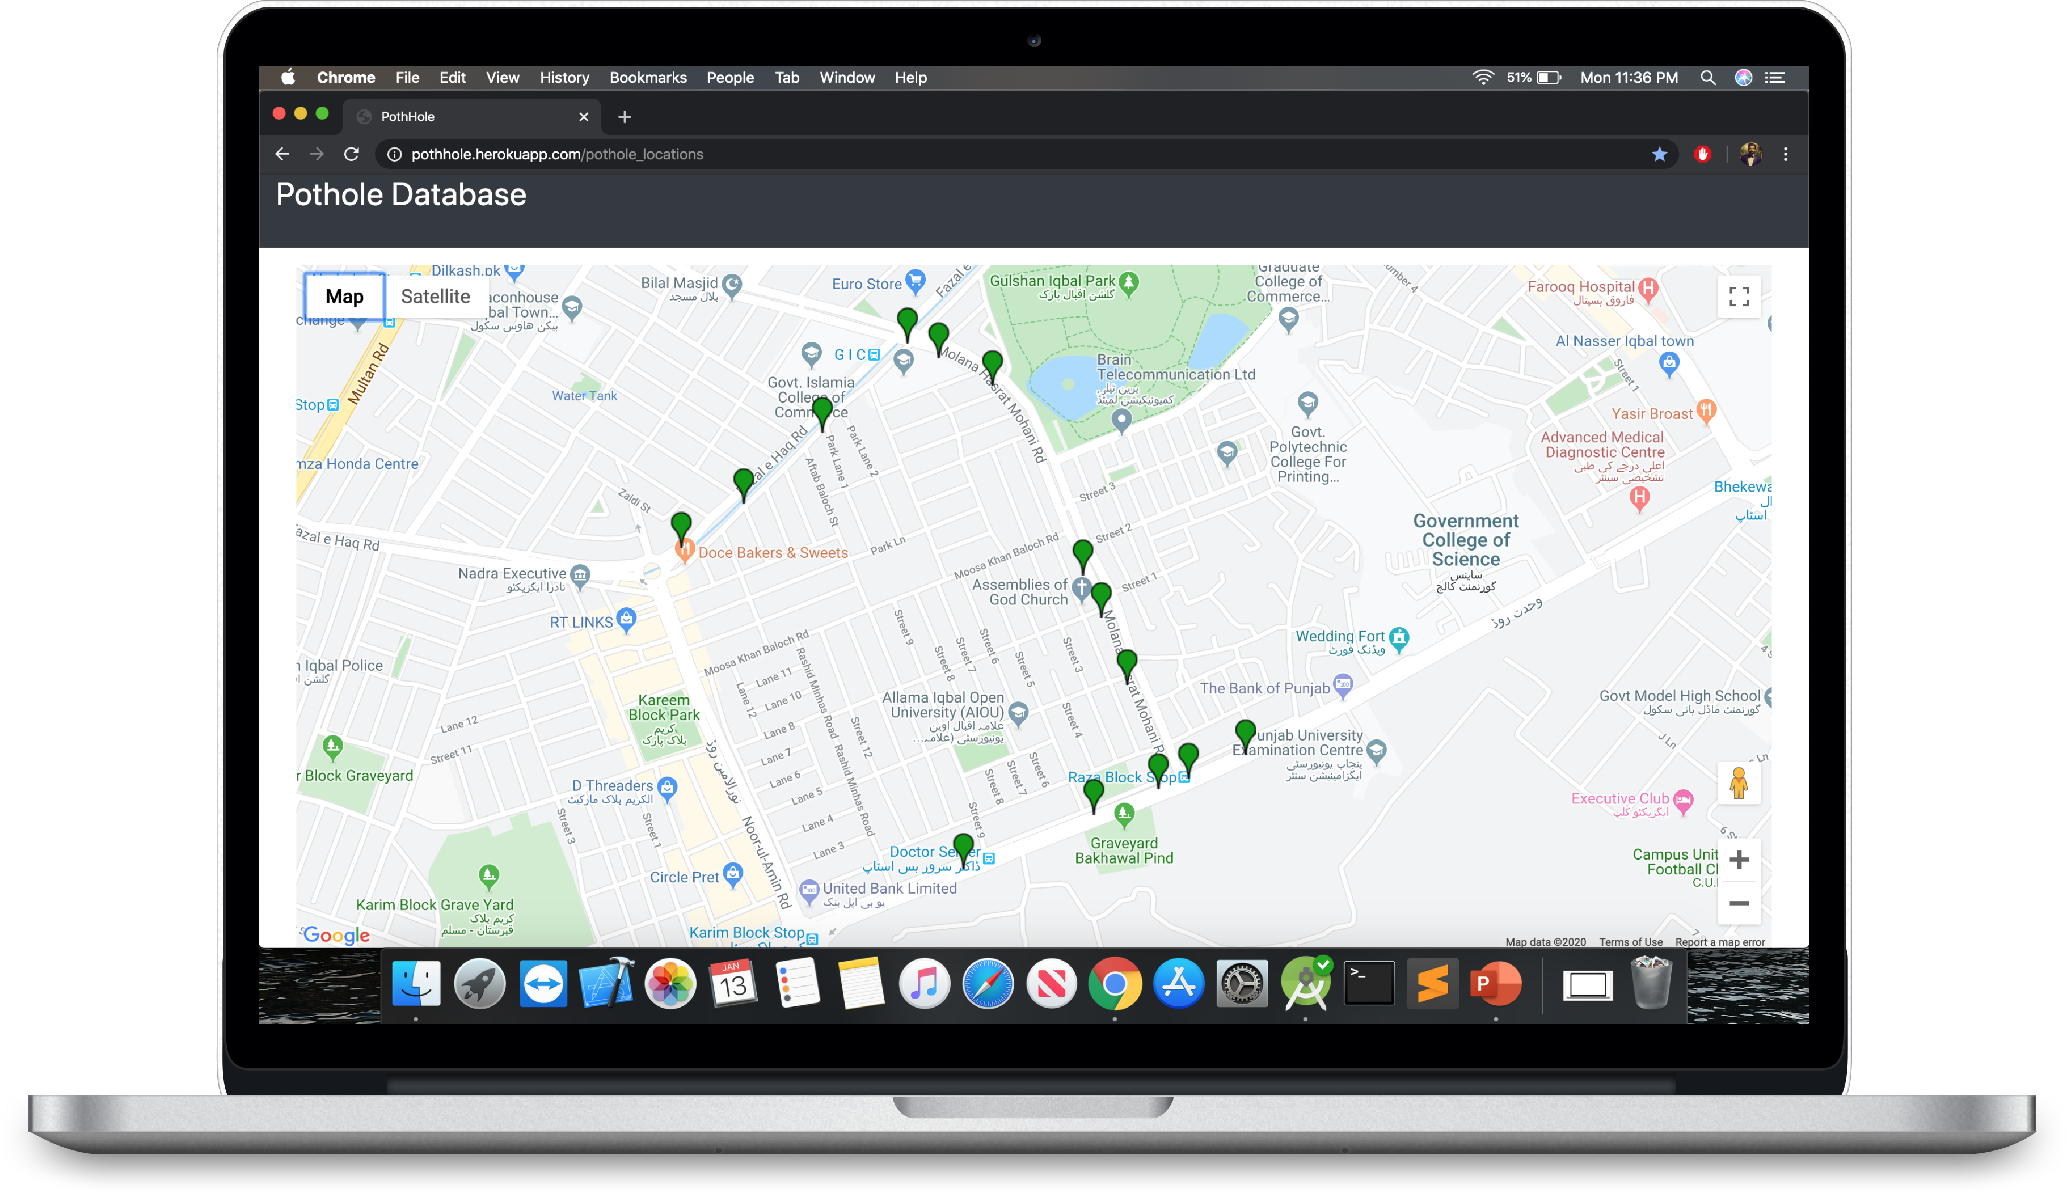
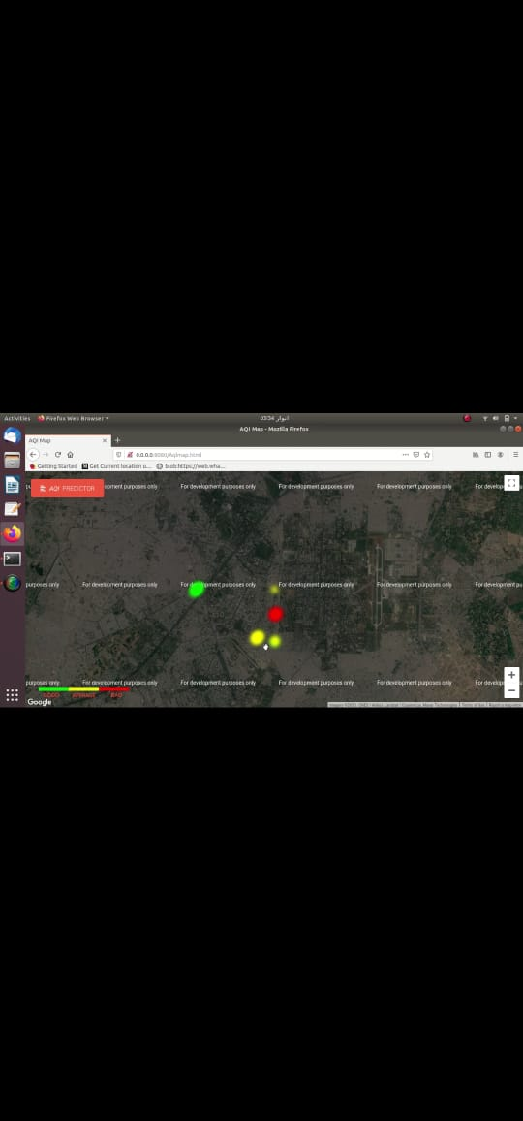
MAP VIEW
Our Application marked AQL of every image on google map which can be viewed through android and web application

Slide 8






Procedure
SAVING RESULT & MARKED LOCATIONS
TURN ON GPS
UPLOAD IMAGE
2
4
6
1
3
5
7
CAPTURING LOCATION
DISPLAY RESULT
TURN ON APP
TURN ON INTERNET

Slide 9


Slide Title
Feature and CONSTRAINTS
User Should have active
Internet Connection.
User needs android device with a working camera and android
Version is 6.0 or above.
User Should have active
Internet Connection

Slide 10
SALIENT FEATURES
1
No exact application is available in Pakistan yet.
2
Application can be used by PMD to spend less time finding the polluted areas and more time to control pollution.
3
This application’s database will be the largest visual collection of marked polluted areas in Pakistan.

Slide 11
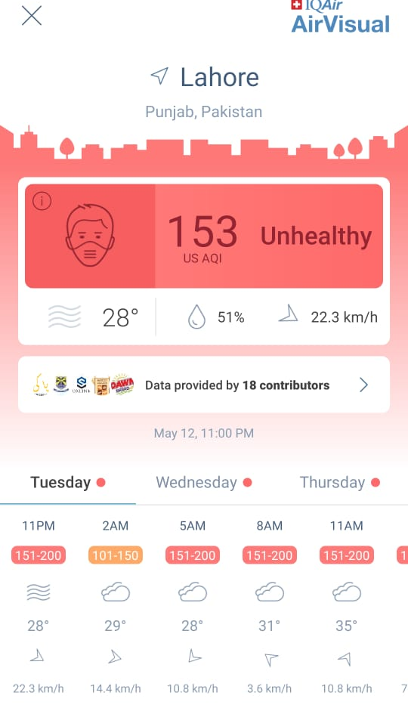
Similar Projects
AirVisual, an app that tells AQI on the basis of various expensive sensors and AQI monitors that are placed around the world. Limited because of unavailability of sensors.
Air Cognizer, similar to our application but limited region wise only to India.

Slide 12



Challenges We Faced
Dataset Collection and Annotation
Selection of Technique
Deployment into Android

Slide 13
Dataset
Collecting the dataset was very difficult as we required a dataset that was either of Pakistan or was near to Pakistan in terms of atmosphere and climate and sky colors
We tried to obtain dataset through multiple sources of Pakistan but we couldn’t find any.
We opted to use dataset of China that we were able to find. It was appropriate as Chinese climate is similar to ours.

Slide 14
Data Argumentation
Technique we used in argumentation are:
Shear
Random Zoom
Flip Left-Right
Translation
Random Crop

Slide 15
Selection of Technique
Either Machine Learning Models or Deep Learning Techniques
Extract features from Images or Feed Image Directly
Regression vs VGG16
VGG16+LSTM or VGG16+Random Forest

Slide 16

Deployment In Android
Convert Keras Model to TensorFlow and embed model into android
OR
Use Flask as backend

Slide 17

Why we select VGG16
Extracts prominent features from the image automatically.
VGG16 is priorly trained on imageNet dataset which makes it prone for the classification task
Lucrative approach and produced a promising accuracy in Image classification tasks
This architecture is flexible and works well on the image Dataset

Slide 18

Using panoptic segmentation to detect sky
Panoptic Segmentation model (from Detectron2 by Facebook) was chosen to detect sky in the pictures. It’s an incredibly intelligent CNN model that can be used to classify both instance segmentation objects and semantic segmentation objects.
We are using it with customized output to check if there is the sky in the picture or not. Having sky in the picture is our requirement to predict AQ level.

Slide 19
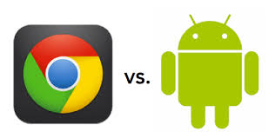
Why we choose android and web
Android was chosen for one reason only: It’s the most accessible platform in the world. Everybody has access to an android smartphone making it incredibly viable to choose android to create an application that could help the masses.
Web was chosen because we wanted a platform where you could upload any picture of anywhere in the world with sky in it to check it. For example you have a photo in your laptop of a place you want to check AQ level of but you don’t have access to a phone right now, you can use our website.

Slide 20
Implementation
Our system connected with the database and the server
Two models used
1st for identifying if sky exists in the picture
2nd for identifying AQL: Our main model
A backend server on which the models are placed and operate on
A database

Slide 21
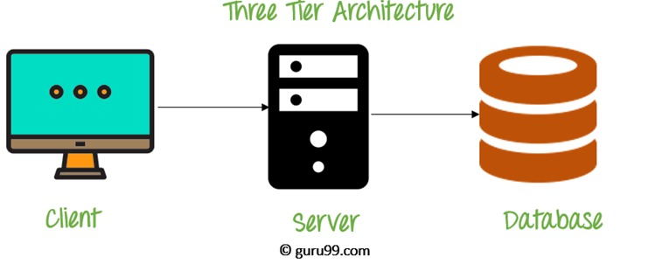
Architecture
Three tier architecture

Slide 22
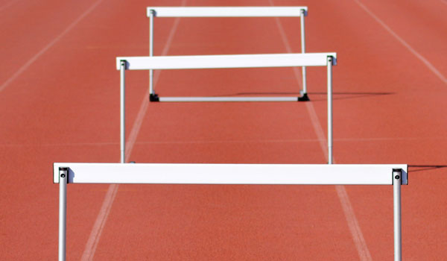
Development Hurdles
Model embedment in the android application and website
Model hunting and choosing the appropriate model
Creating an environment where the models could work in conjunction with each other to perform the tasks

Slide 23

Wrap it UP!
An AQI Predictor system that predicts Air Quality level.
Consists of an android application and a website.
The whole process is done in a simplistic manner using the photo taken through the android smartphone’s camera to use to predict Air Quality level.
Results can be procured from the app/website based on the picture.

Slide 24
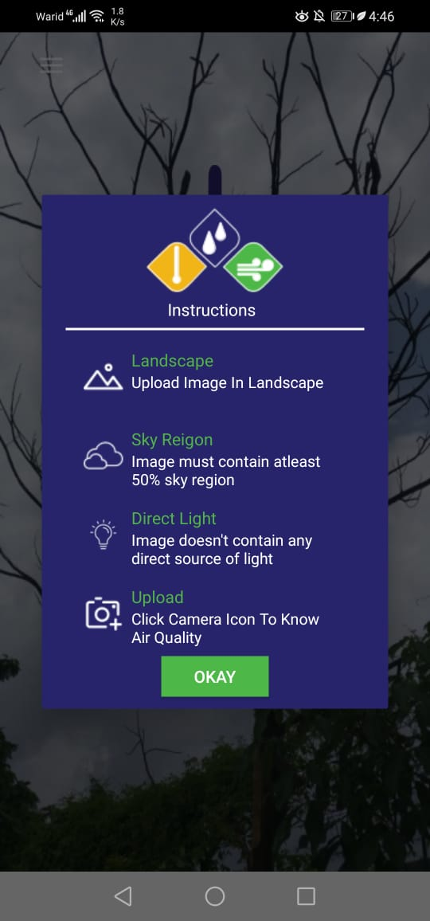
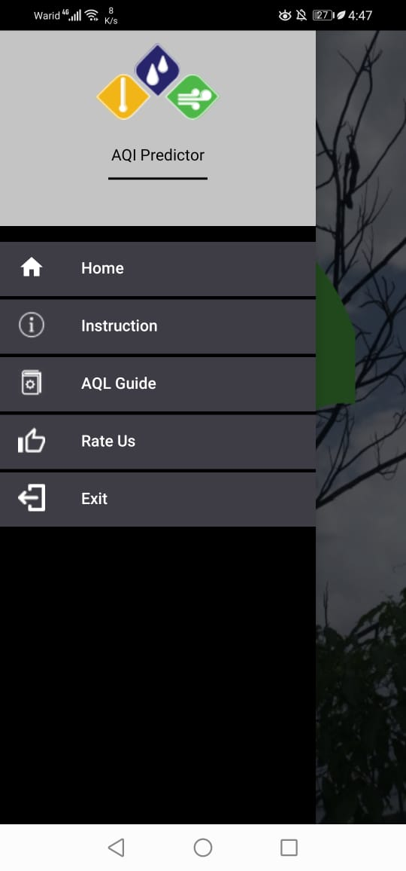
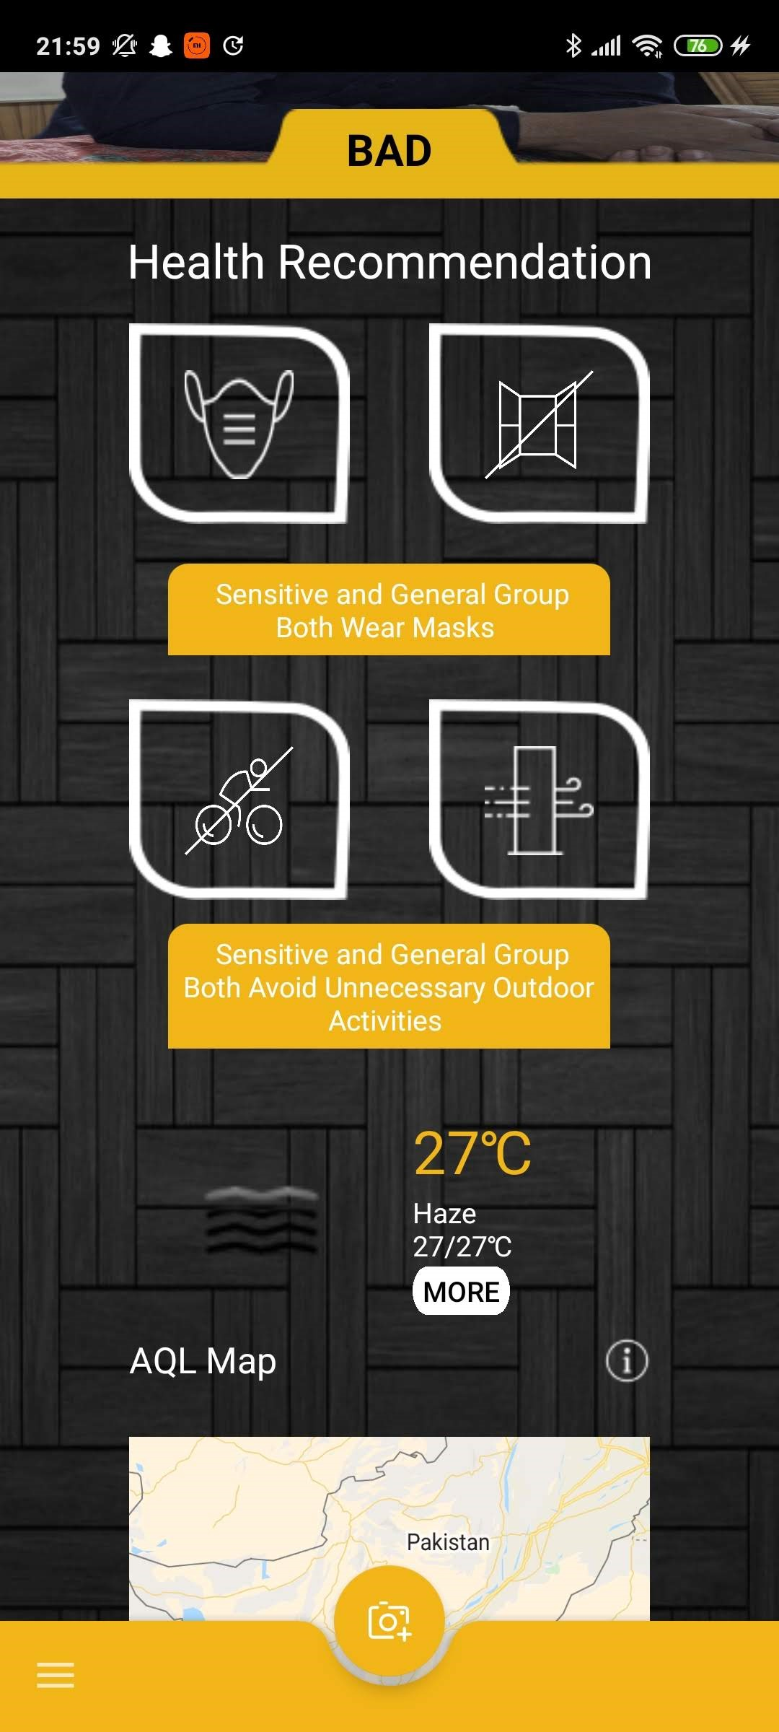
Android Application Interface

Slide 25
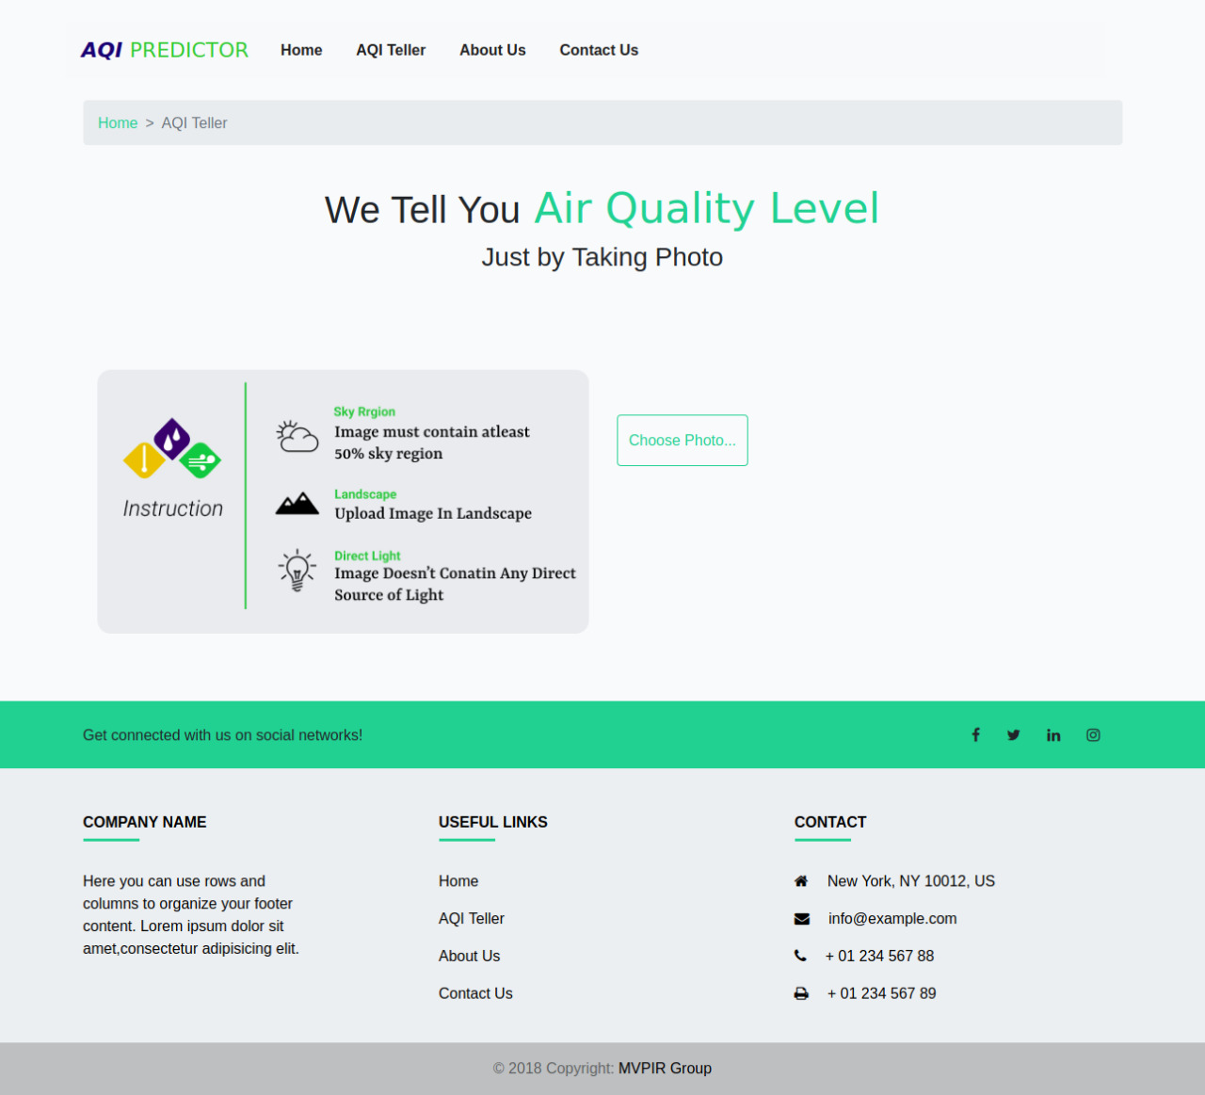
Web Application Interface

Slide 26

WORK FORWARD
Can be improved to extend usage to pictures without sky and without enough light
Can be improved to calculate AQI
Can further increase accuracy if a more appropriate dataset can be obtained

Slide 27










TOOLS & TECHNIQUES

Slide 28



CONNECT US Via….
MPVIR
GitHub
Our Work is cited at Machine Perception & Visual Intelligence Research Group
https://sites.google.com/view/mpvir/
Find our Work at GitHub

Slide 29



Additional Working…
Writing a Journal Research Paper.
Team AQI Predictor Collaborating
with PMD Pakistan.

Slide 30
Acknowledgement
Our heartiest gratitude to Dr. Usama Ijaz Bajwa, colleagues and everybody who helped us in anyway with their thoughts, skills or any productive way.
We would also like to thank our institute, Comsats University Islamabad, Lahore Campus, for their providing us a platform to work on as well as helping us in any way possible. This would not have been possible without it.

Slide 31
Completed Tasks
Research existing solutions, Requirement gathering, Prioritizing the requirements
Documentation (Use cases, sequence diagrams)
Gathering the data to train the model and designing the front-end
Development of interfaces
Training of the model
Integrating the front-end and backend

Slide 32
Incomplete Tasks
Formal testing of application and website
Deployment
FYP-II Report

Slide 33
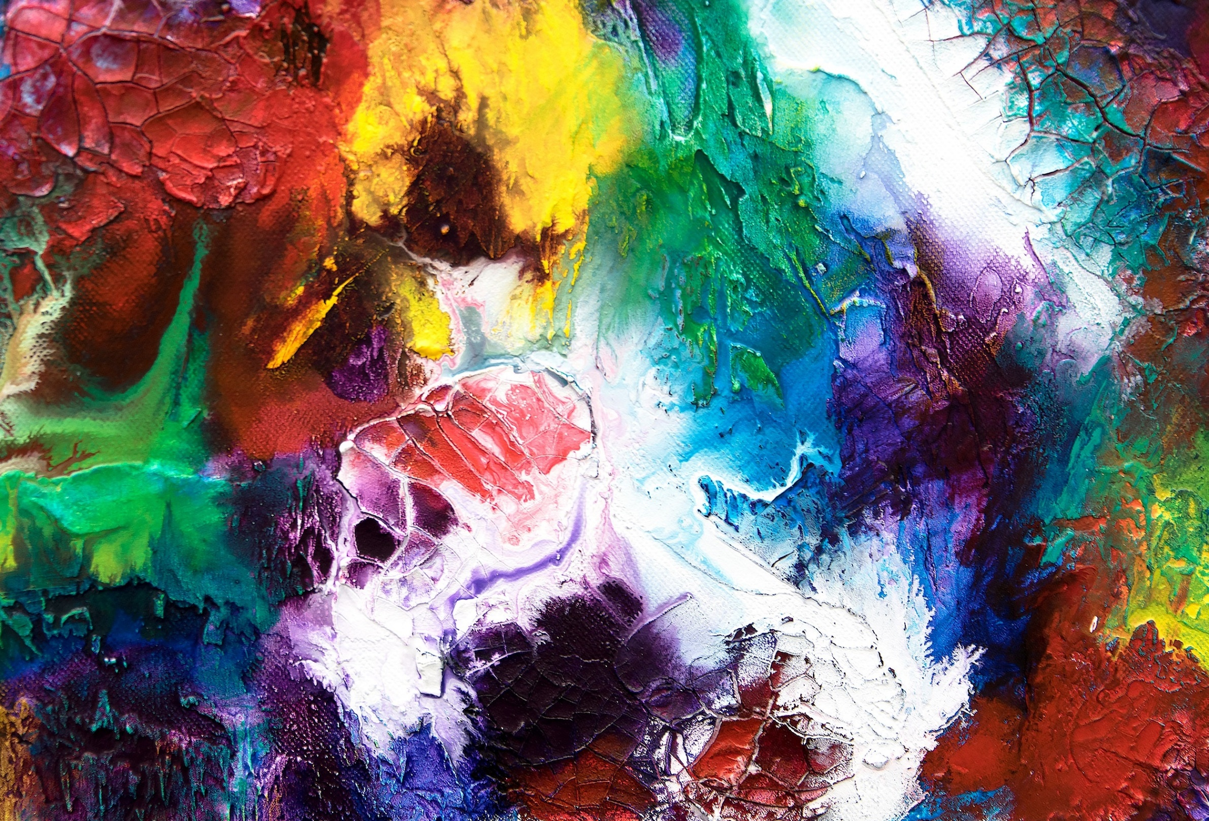
JazakAllah
Any Question??

